Slide 1
To Illustrate Binary Similarity Coefficient And Clustering Methods On The Given Datasets
Submitted By:
Abhishek Singh (#100329581)
Nancy Rai (#100328966)
Samar Abbas Shariff (#100329370)

Slide 2
Objective Of The Project:
On ‘Social Media Ads’ dataset, we performed Binary Similarity Coefficient such as Simple Matching, Jaccard and Dice to study the relationship between the user, who has purchased a product by clicking on the advertisements, based on gender, age and estimated salary
On ‘Top 50 singers on spotify’ dataset we performed cluster analysis based on Track Name, Artist Name, Genre, Beats Per Minute, Energy, Danceability, Loudness dB, Liveness, Valence, Length, Acousticness, Speechiness, Popularity
Language used R and SAS.
Notes:
There are 2 tasks in our project for eachtask we have different datasets.
For task 1 we used social_media_ads dataset where we perfomed
For task2 we used top_50_singer_on_Spotify datasets

Slide 3
Datasets Description
Variable Name | Description | Type
User ID | Consumer User ID | Quantitative:Nominal
'Age' | Consumer age in years | Quantitative: Ratio
'Estimated Salary' | Estimated salary of Consumer | Quantitative:Ratio
'Gender' | Gender of consumer | Categorial: Nominal
'Purchased' | Did the consumer purchase? | Categorical: Nominal
For Binary Similarity Coefficient:
Social Network Ads Data from https://www.kaggle.com/akram24/social-network-ads
Number of Observations = 400
Number of Variables=5

Slide 4
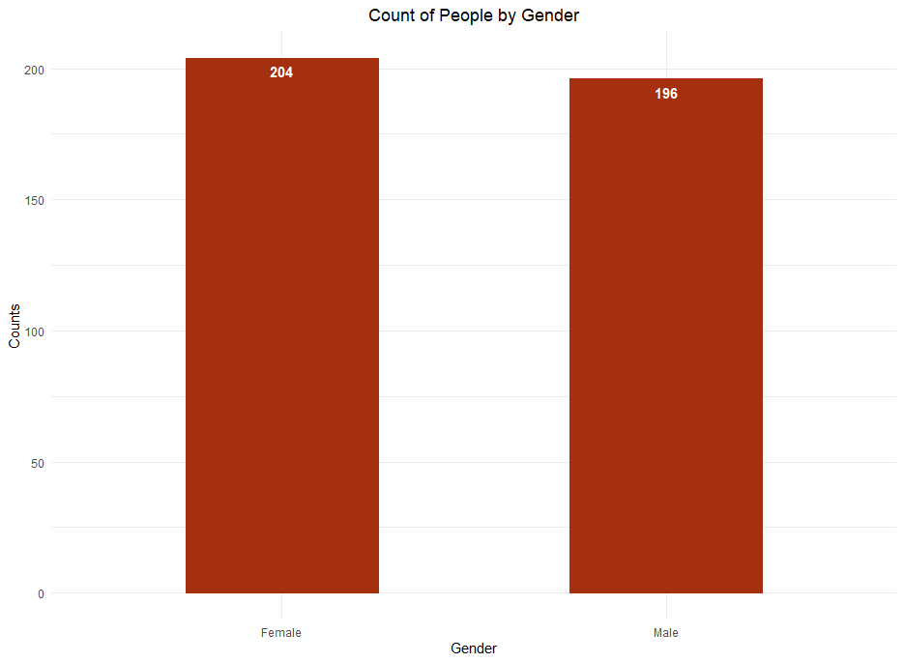
EDA: Social Network Ads

Slide 5
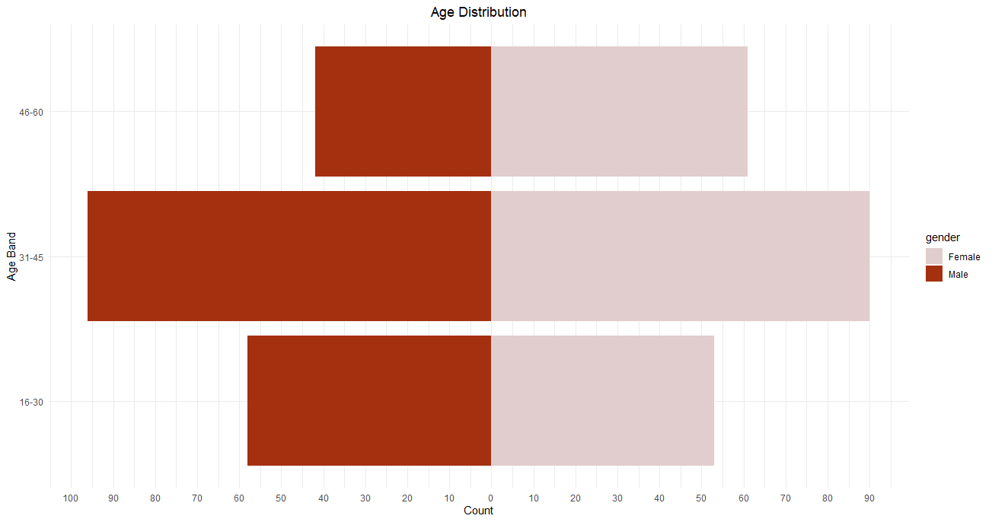
EDA: Social Network Ads contd..

Slide 6
Datasets Description contd..
Variable Name | Description | Type/Scale
Track Name | Name of the track | Nominal
Artist Name | Name of the Artist | Nominal
Genre | The genre of the track | Nominal
Beats Per Minute | The tempo of the song. | Quantitative: Ratio
Energy | The energy of a song - the higher the value, the more energetic | Quantitative: Ratio
Danceability | The higher the value, the easier it is to dance to this song. | Quantitative: Ratio
Loudness dB | The higher the value, the louder the song. | Quantitative: Ratio
Liveness | The higher the value, the more likely the song is a live recording. | Quantitative: Ratio
Valence | The higher the value, the more positive mood for the song. | Quantitative: Ratio
Length | The duration of the song. | Quantitative: Ratio
Acousticness | The higher the value the more acoustic the song | Quantitative: Ratio
Speechiness | The higher the value the more spoken word the song contains. | Quantitative: Ratio
Popularity | The higher the value the more popular the song is. | Quantitative: Ratio
For Clustering:
Top 50 Spotify Songs Data from https://www.kaggle.com/leonardopena/top50spotify2019
Number of Observations = 50
Number of Variables=13

Slide 7
Purpose Of The Project
The dataset “Social Network Ads” is used to compare similarity between the customers based on purchasing pattern. This will help the business to understand the pattern & segment of similar customer and increase its sales by targeting the similar customers.
The dataset “Top 50 Spotify” is used to perform various clustering methods to cluster the singers into groups and help business understand which singers are similar in nature so that they can improve the recommendation system for customer.

Slide 8
Binary Similarity Coefficient
The similarity measure which deals with binary data is called binary similarity coefficient.
Methods to be used:
i) Simple Matching
ii) Jaccard
iii) Dice

Slide 9
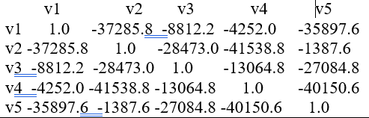
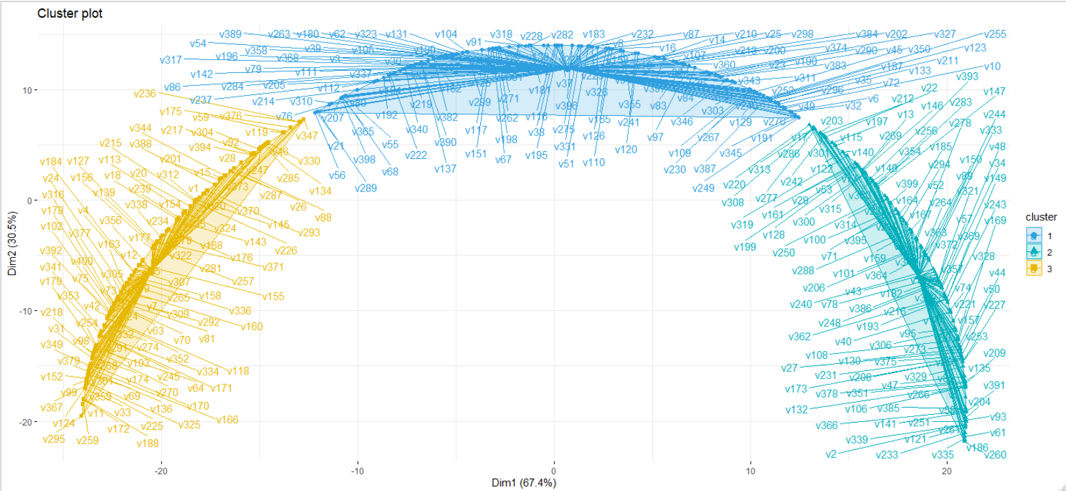
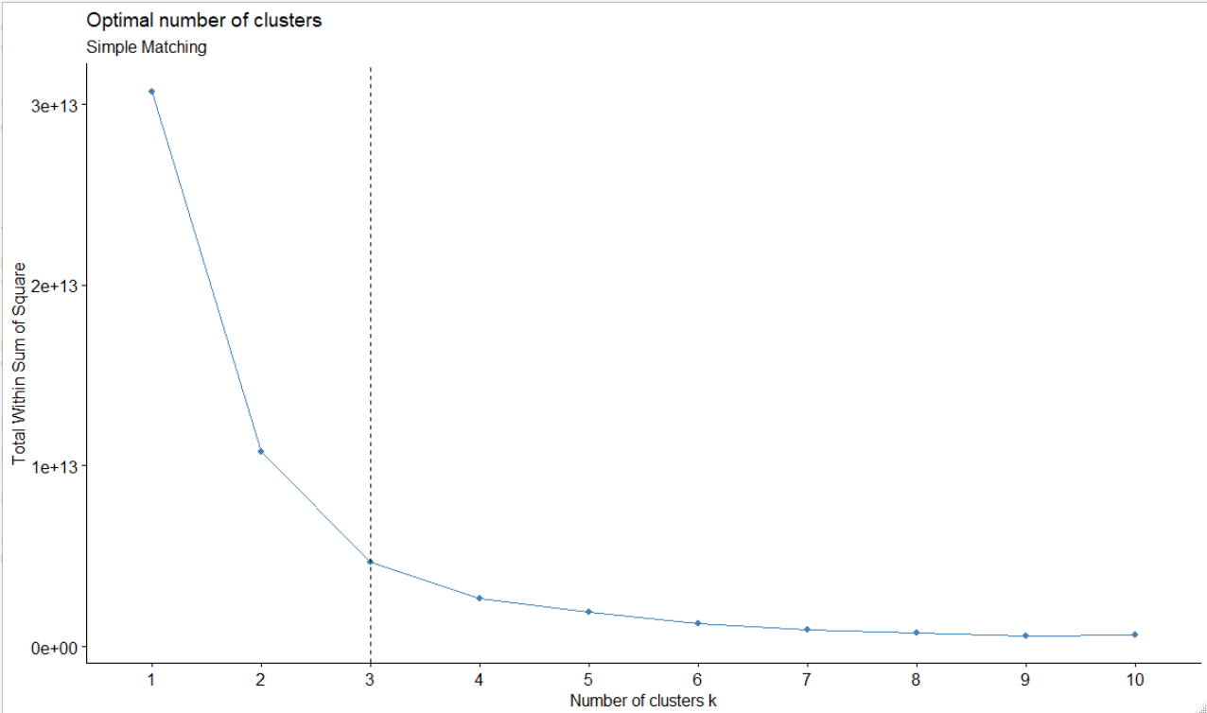
1. Simple Matching
1. Similarity matrix (method = “simple matching”)
2. Elbow method to find optimal no. of clusters (k=3).
3. Cluster plot of 3 clusters formed by kmeans.

Slide 10
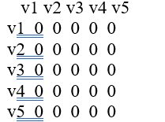
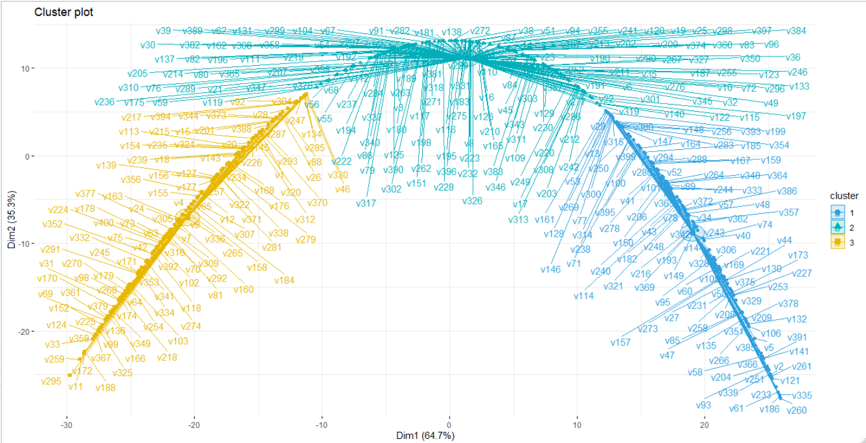
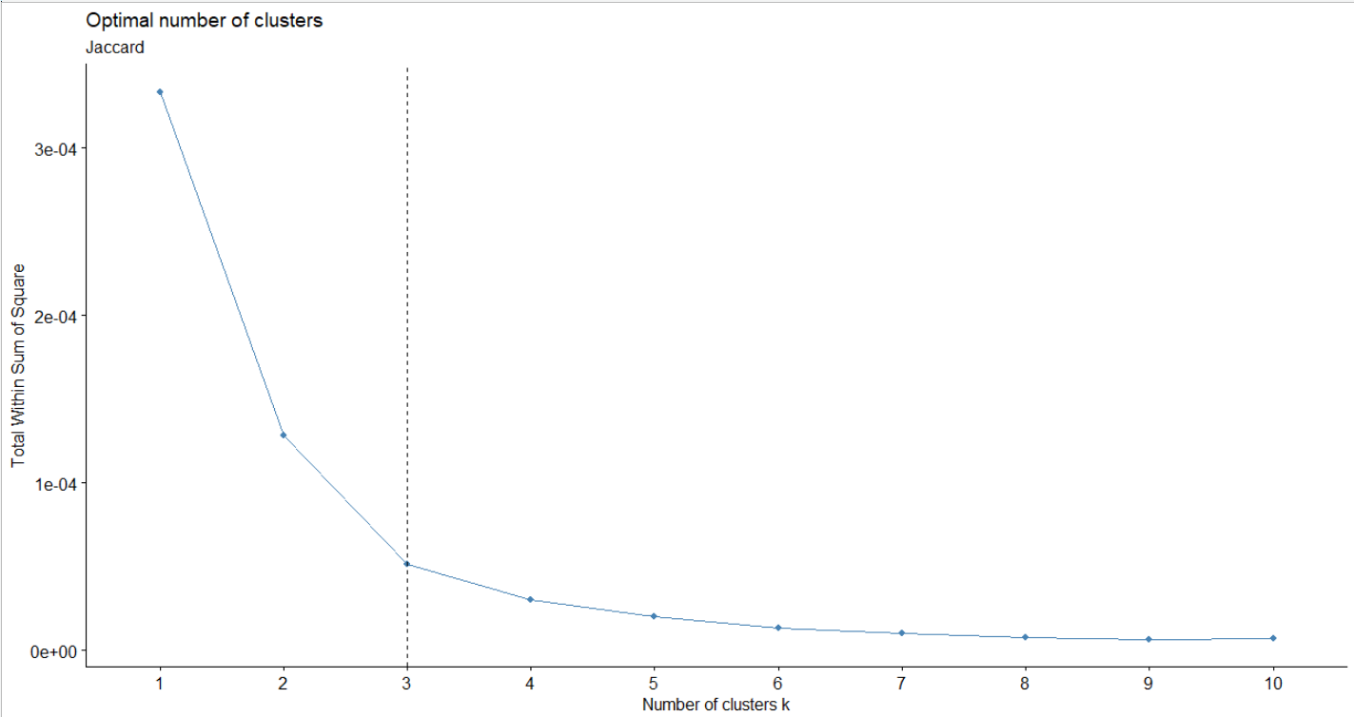
2. Jaccard
1. Similarity matrix (method = “jaccard”)
2. Elbow method to find optimal no. of clusters (k=3).
3. Cluster plot of 3 clusters formed by kmeans.

Slide 11
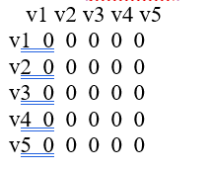
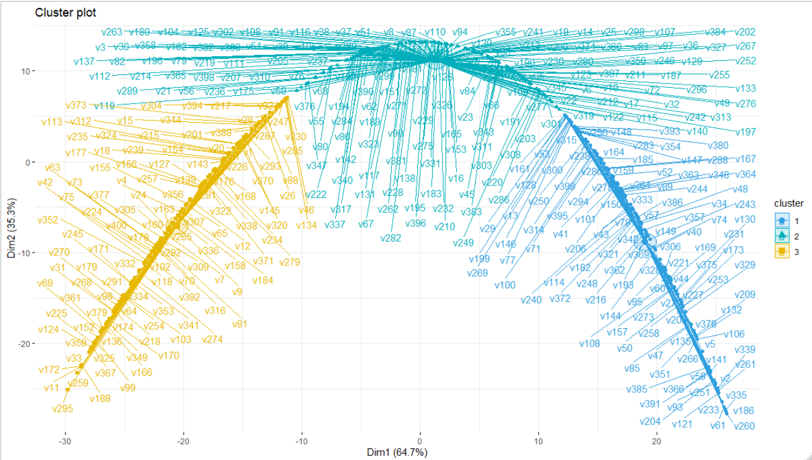
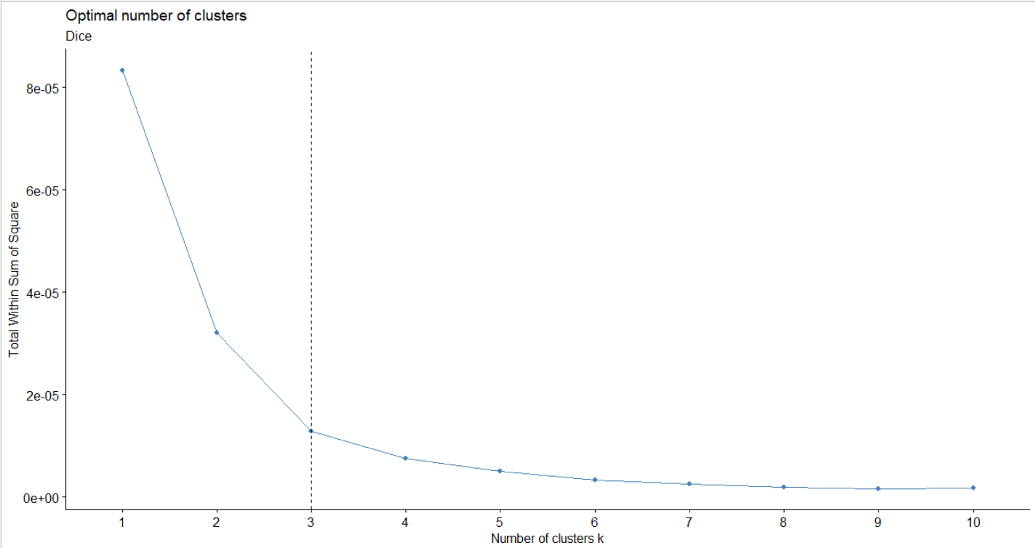
3. Dice
1. Similarity matrix (method = “jaccard”)
2. Elbow method to find optimal no. of clusters (k=3).
3. Cluster plot of 3 clusters formed by kmeans.

Slide 12
Conclusion of Binary Similarity Coefficient:
Segments of customer based on their purchasing behaviour
Focus on the most profitable customer
Improve customer relationship and service
Upsell and cross sell other products and service

Slide 13
Cluster Analysis
Cluster analysis is an approach that finds structure in the dataset by identifying natural groupings in the dataset. We used “Top 50 Songs” dataset to perform different clustering methods.
Clustering
Hierarchical
Agglomerative
Divisive
Partitional
K-Means
K-Medoid
Image 1: Clustering methods.

Slide 14
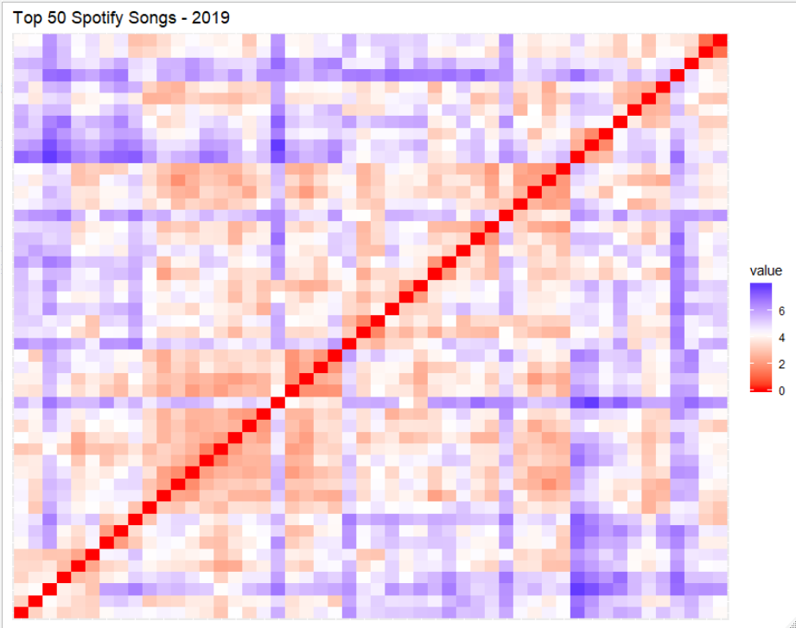
Assessing Cluster Tendency
Method 1: Statistical method by computing Hopkins statistics.
Method 2: Visual method: using VAT(Visual Assessment of Clustering Tendency)

Slide 15
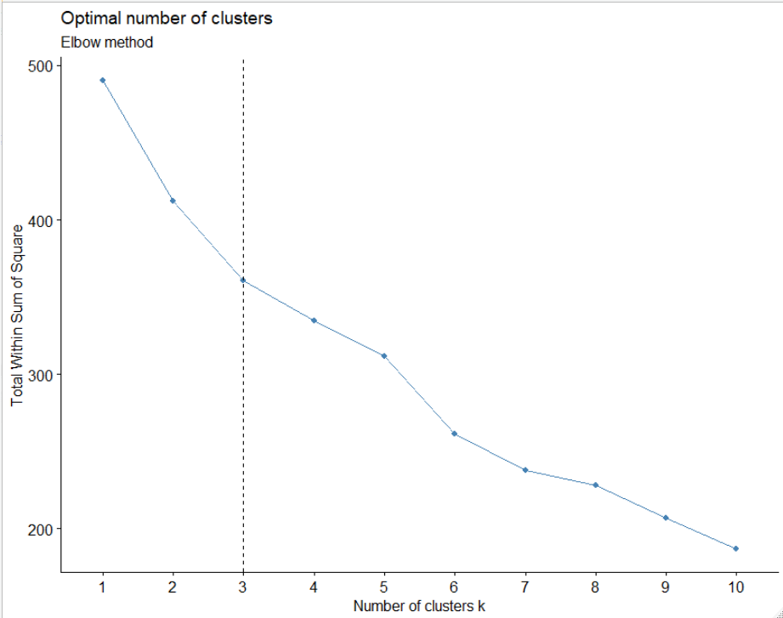
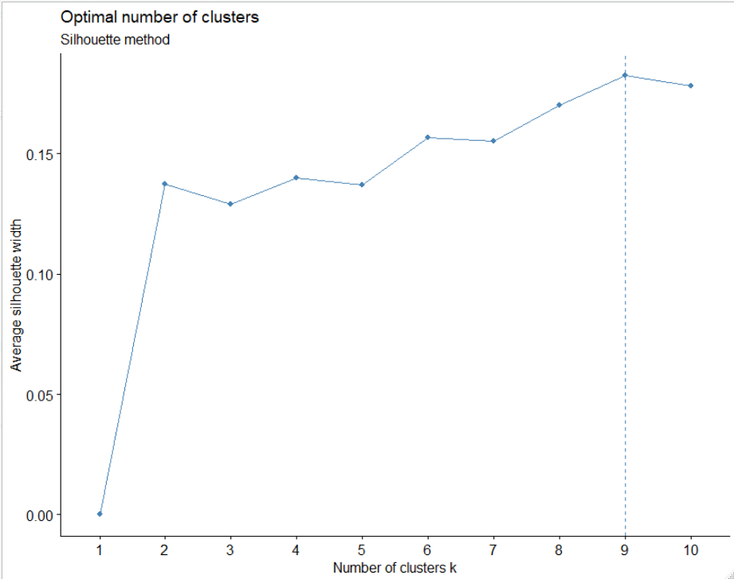
Finding Out The Optimal No. Of Clusters
Methods used: Elbow Method, Silhouette Method, Gap Statistics Method and NbClust() function.
1. Elbow Method (k=3)
2. Silhouette Method (k=9)

Slide 16
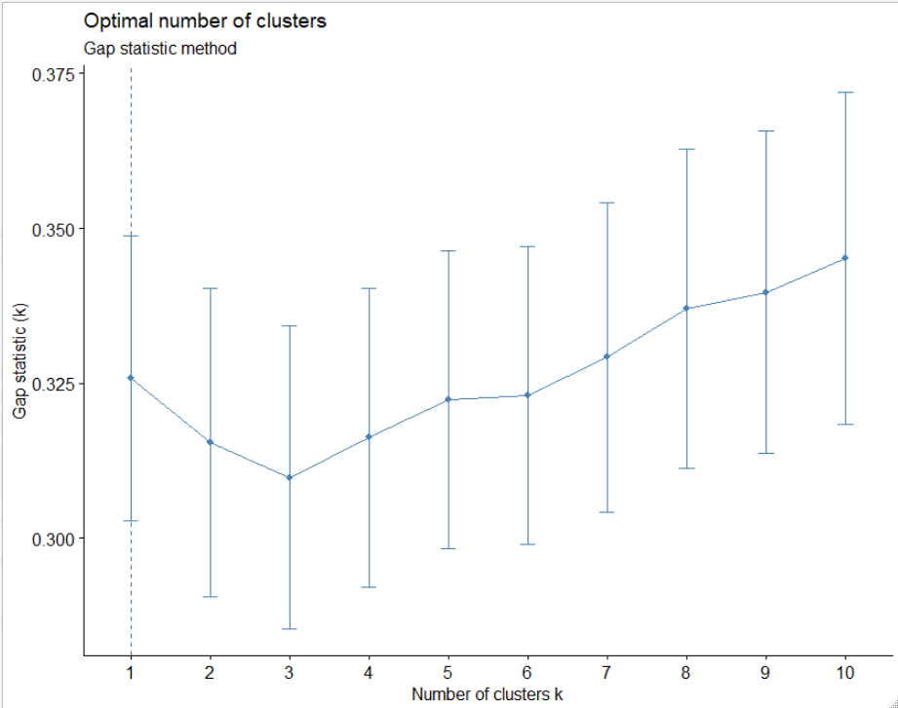
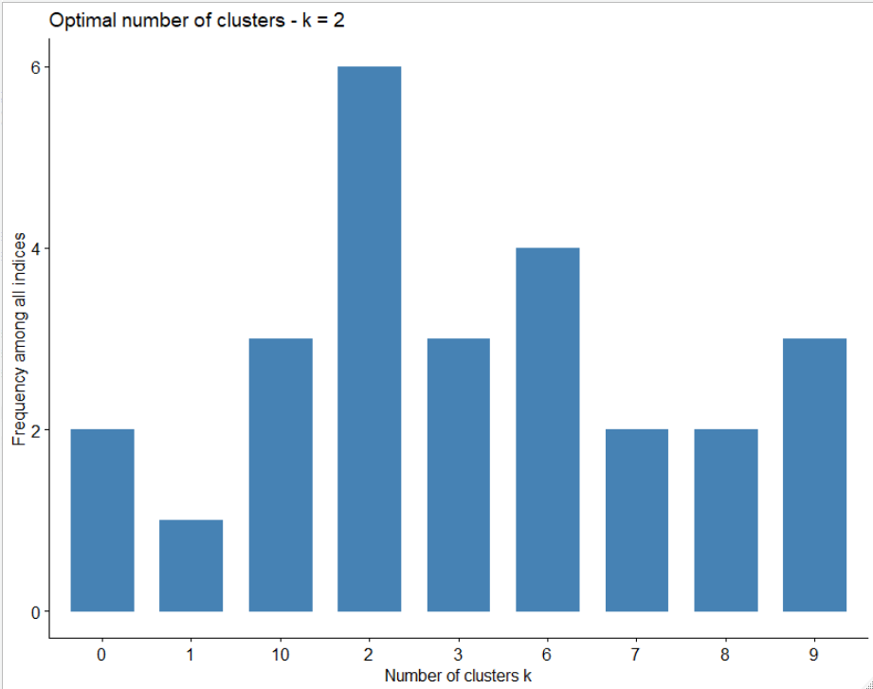
Finding Out The Optimal No. Of Clusters contd..
3. Gap Statistics (k=10)
4. NbClust() (k=2)
Conclusion: We will go with the result of NbClust() which tells that the optimal number of clusters is 2 for our dataset “Top 50 Songs”.

Slide 17
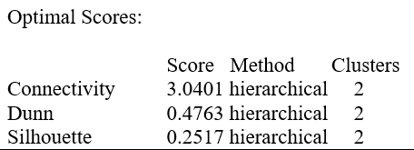
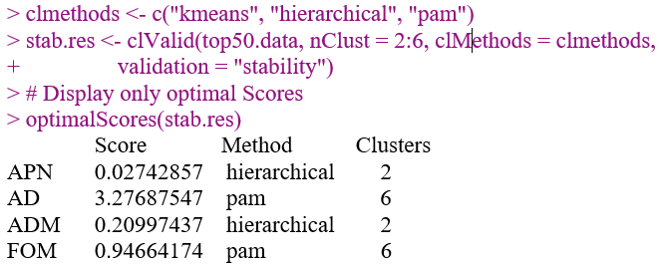
Best Clustering Algorithm
Used clvalid() with internal validation measures i.e. connectivity, dunn and silhouette
Used clvalid() with stability validation measures i.e. APN, ADM, AD and FOM.
Output: Hierarchical method with k=2 is best
Output: Hierarchical method with k=2 is best for APN and ADM whereas Pam with k=6 is better for AD and FOM.

Slide 18
Hierarchical Clustering
Agglomerative Clustering: Includes linkage methods
Single Linkage
Complete Linkage
Average Linkage
Ward Linkage
Divisive Clustering.

Slide 19
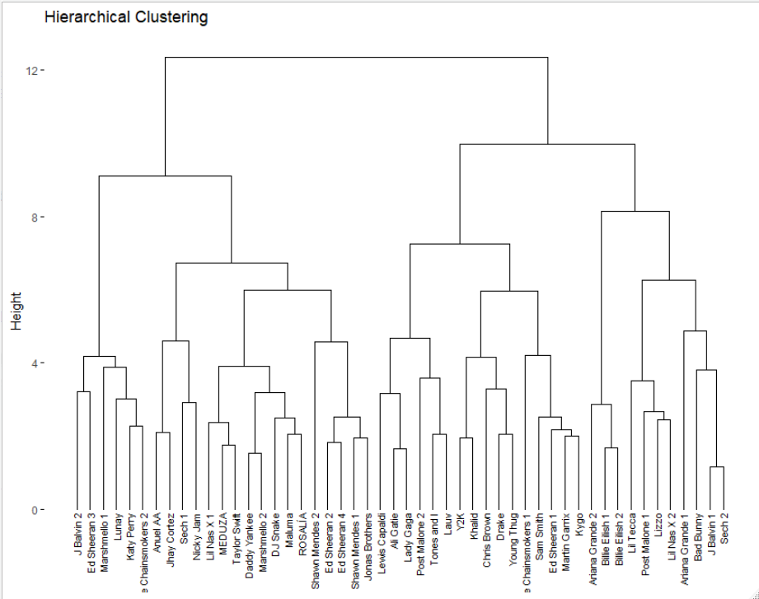
Hierarchical Clustering
Dendrogram of hierarchical clustering for dataset “Top 50 Songs”

Slide 20
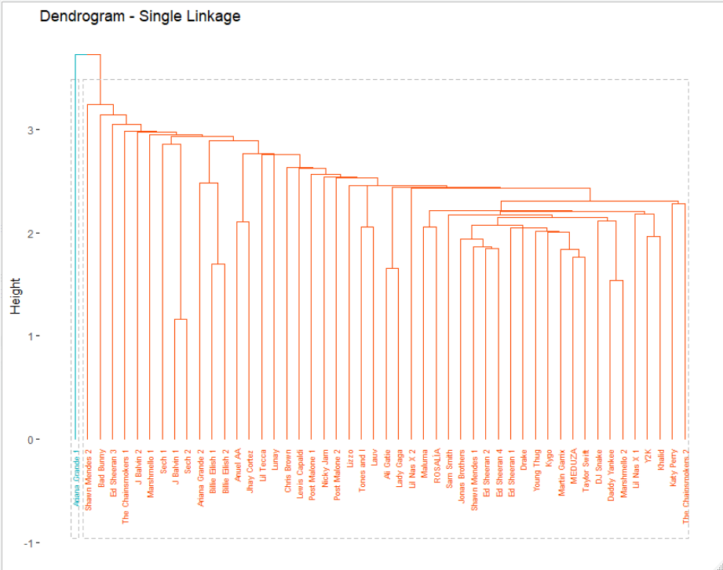
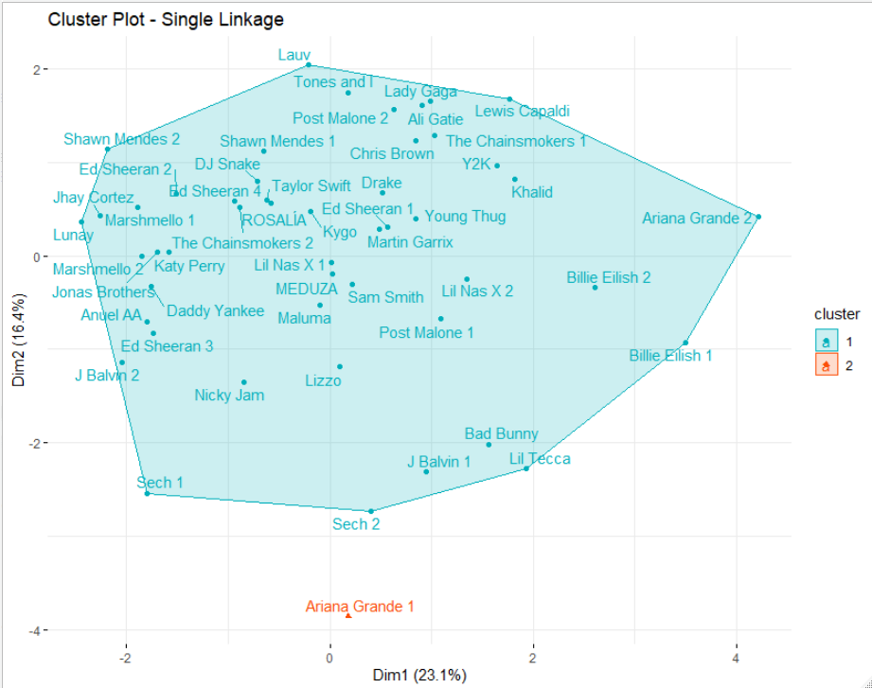
Agglomerative Clustering: Single Linkage
Dendrogram of single linkage with k=2
Cluster plot of single linkage with k=2

Slide 21
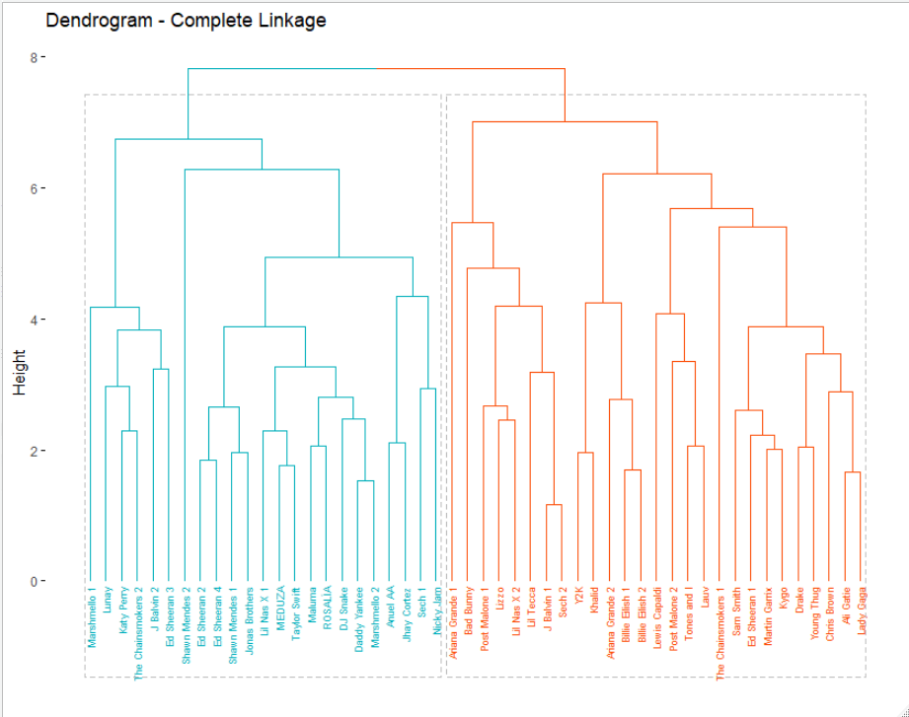
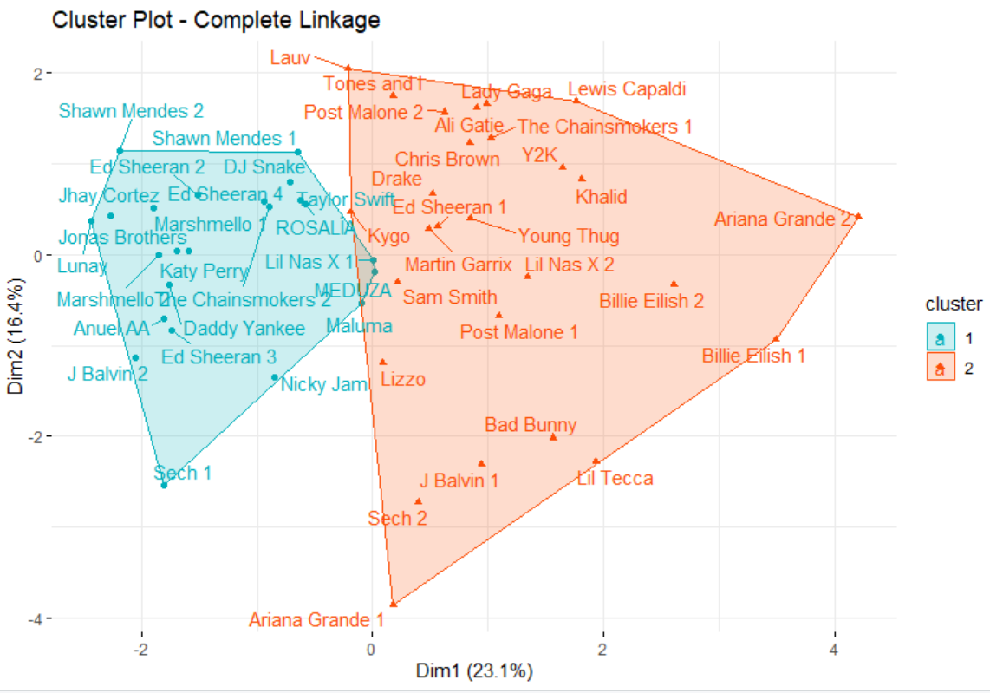
Agglomerative Clustering: Complete Linkage
Dendrogram of complete linkage with k=2
Cluster plot of complete linkage with k=2

Slide 22
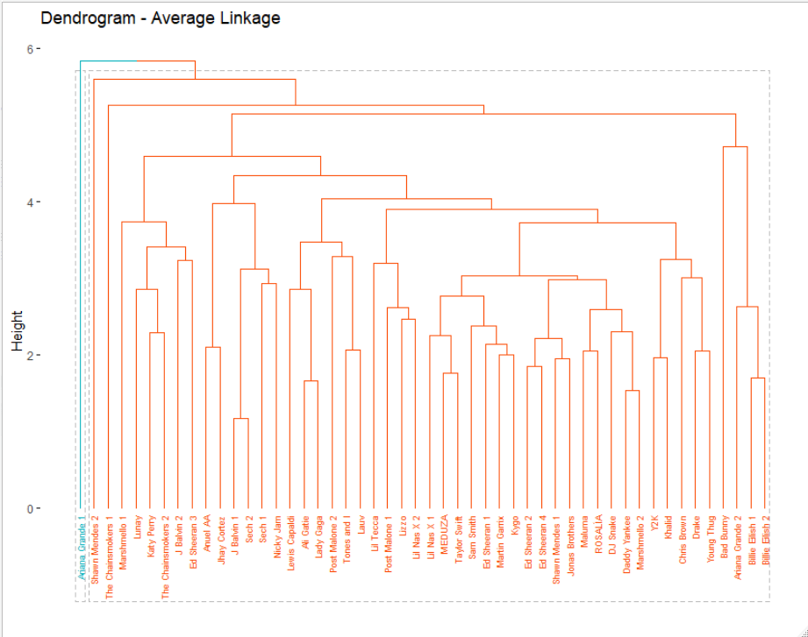
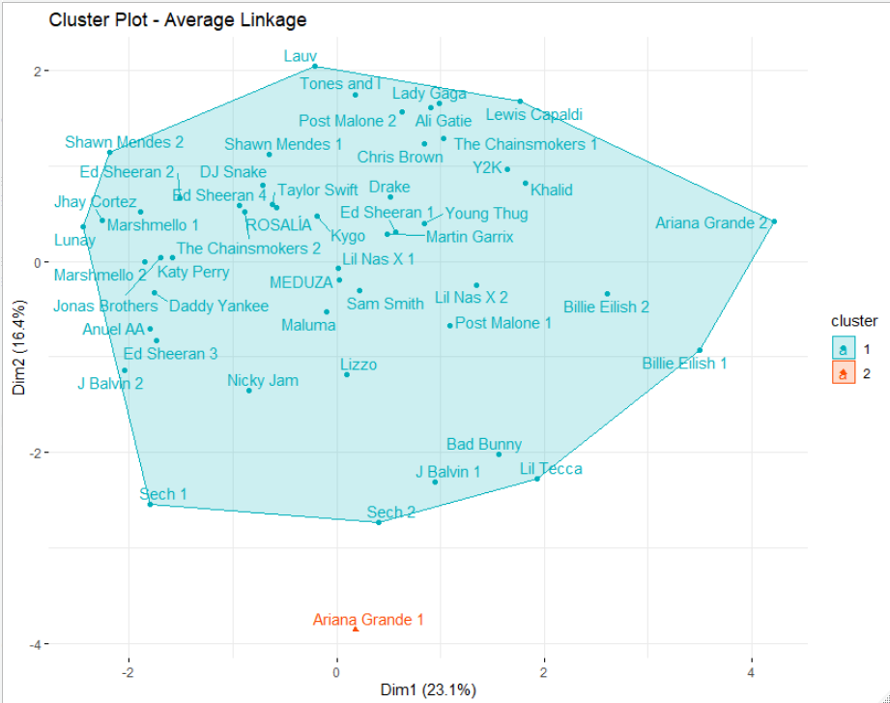
Agglomerative Clustering: Average Linkage
Dendrogram of average linkage with k=2
Cluster plot of average linkage with k=2

Slide 23
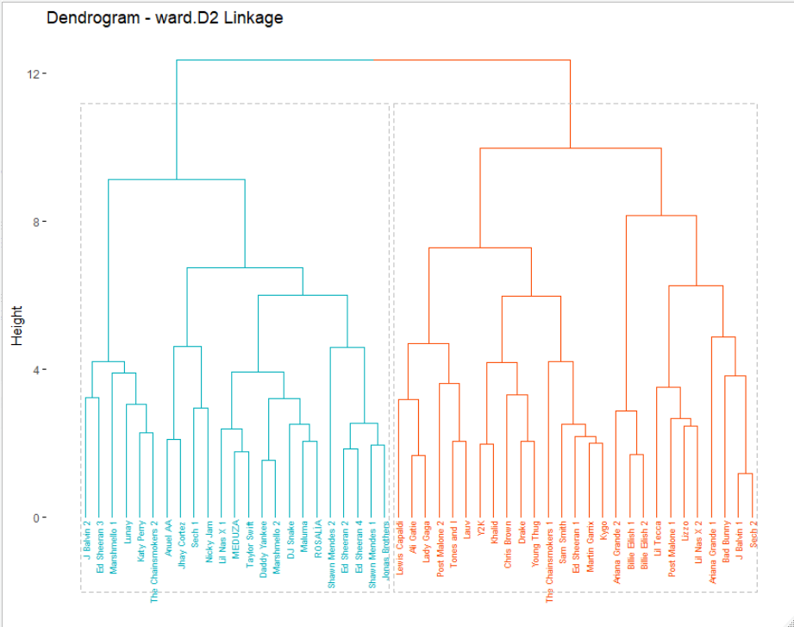
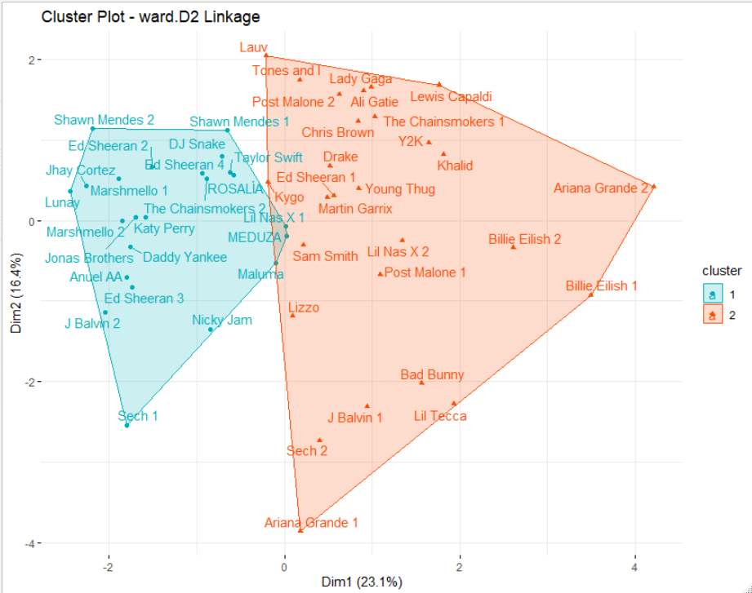
Agglomerative Clustering: Ward Linkage
Dendrogram of ward.D2 linkage with k=2
Cluster plot of ward.D2 linkage with k=2

Slide 24
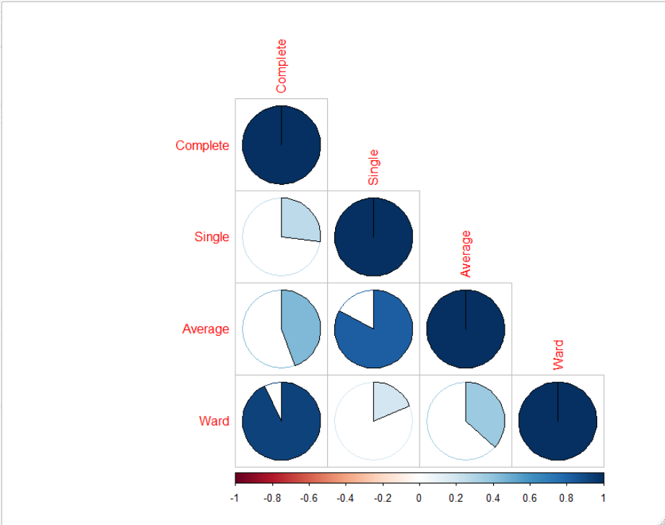
Correlation plot of all linkage methods
Result: From the correlation matrix, ward and complete has the maximum correlation and second maximum value is for single and average.

Slide 25
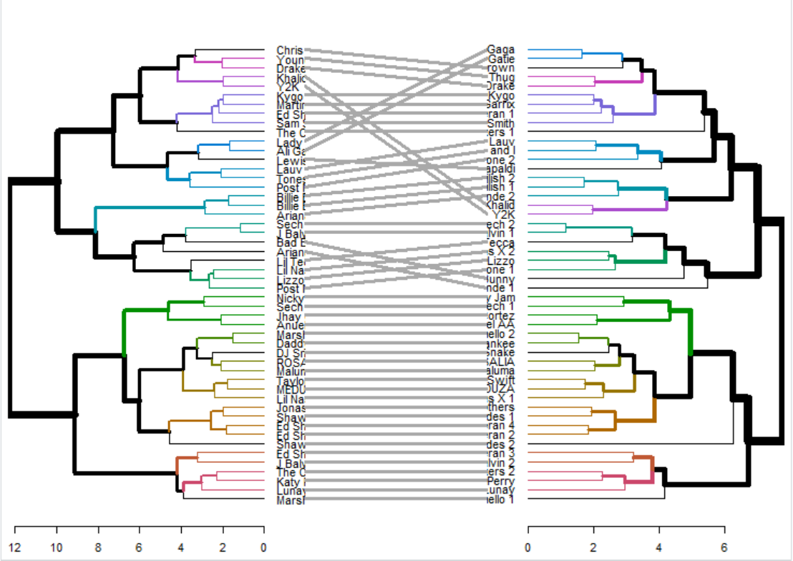
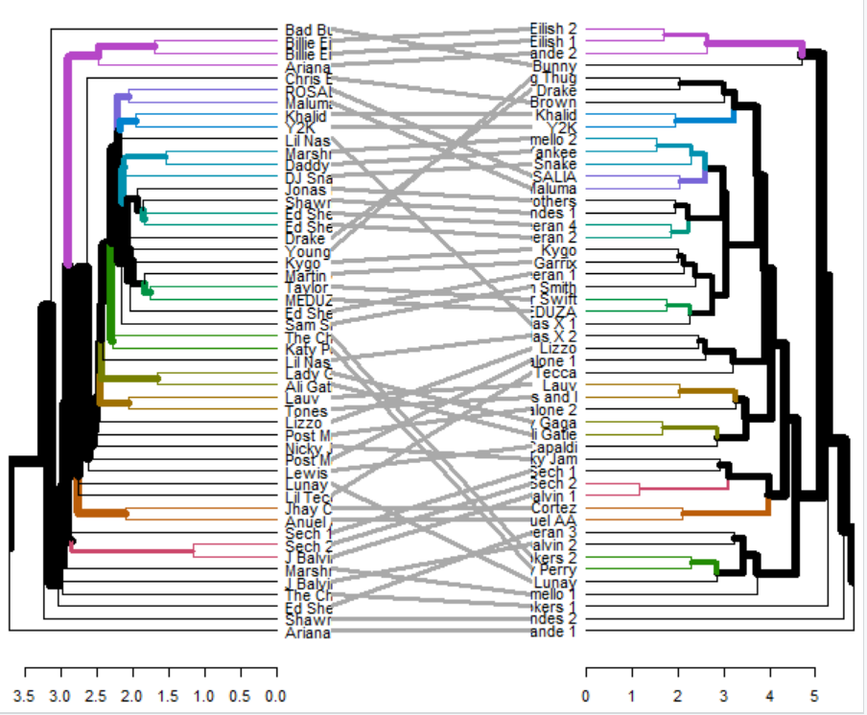
Dendrogram Comparison
Comparison b/w ward linkage and complete linkage
Comparison b/w single linkage and average linkage

Slide 26
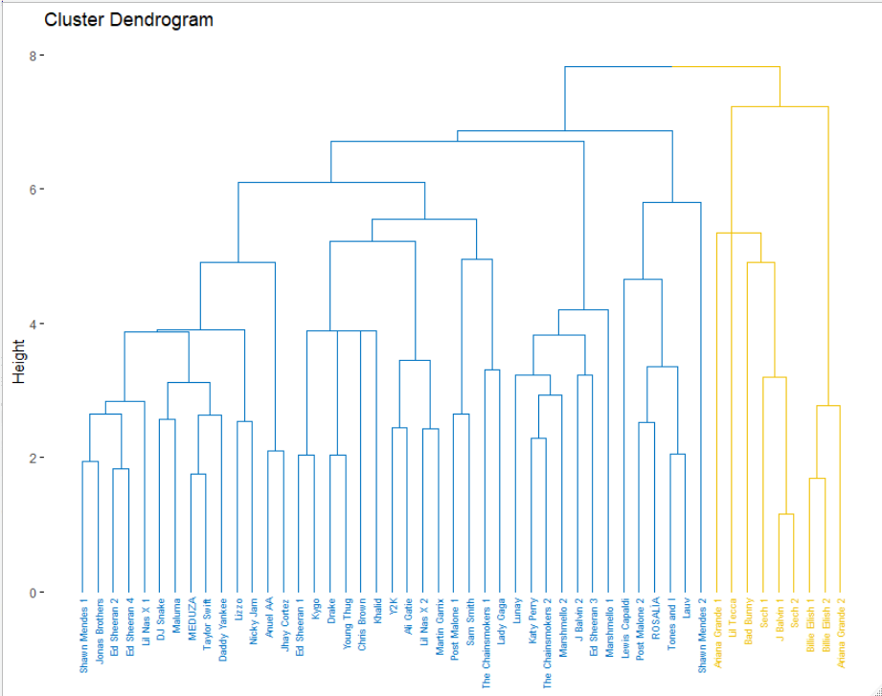
Divisive Clustering
Dendrogram of divisive hierarchical clustering for dataset “Top 50 Songs”

Slide 27
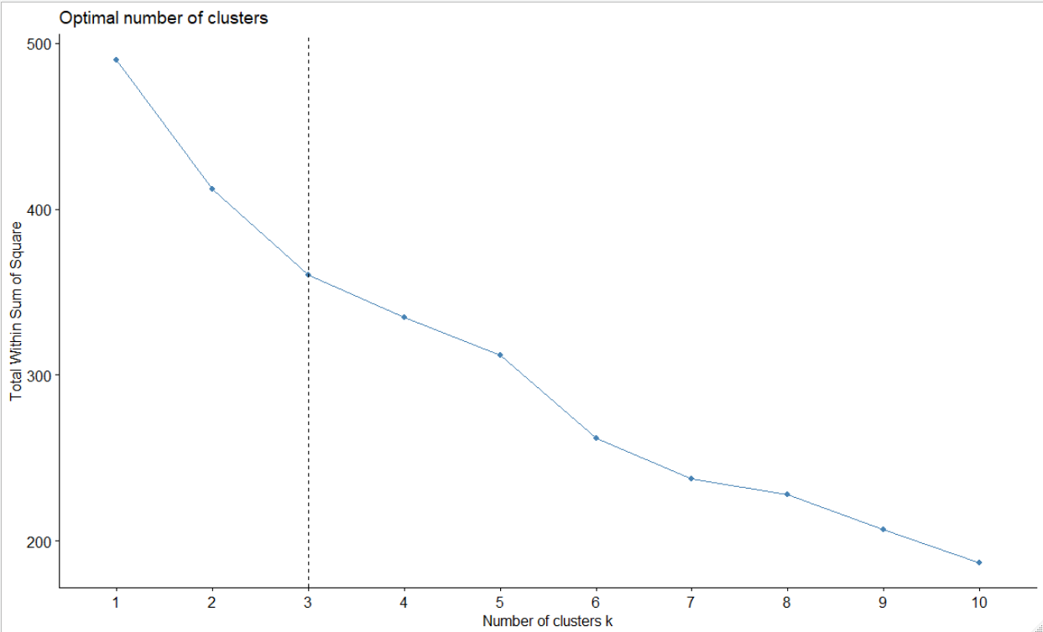
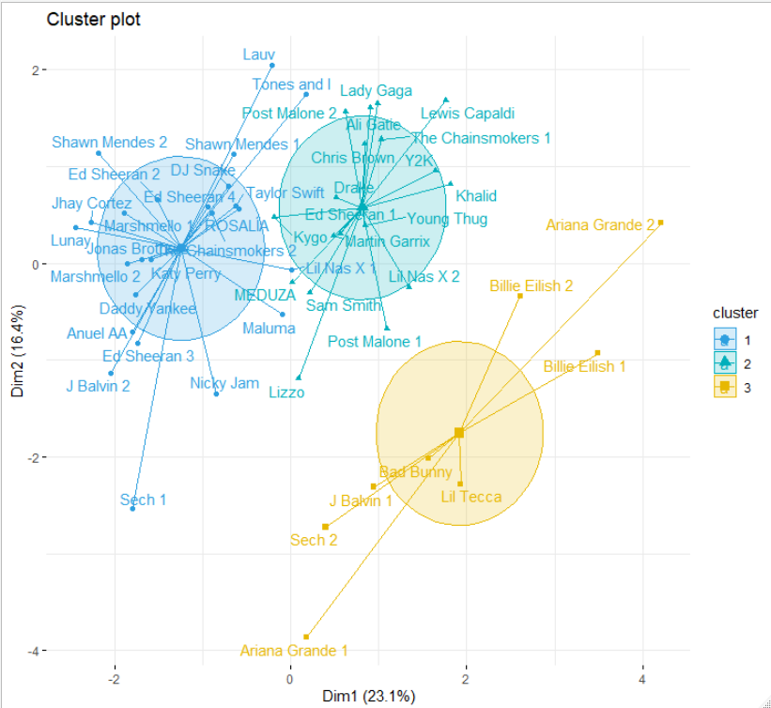
Partitional Clustering: K-Means
Elbow Method tells that optimal no. of clusters is 3
Clusters formed by taking k=3

Slide 28
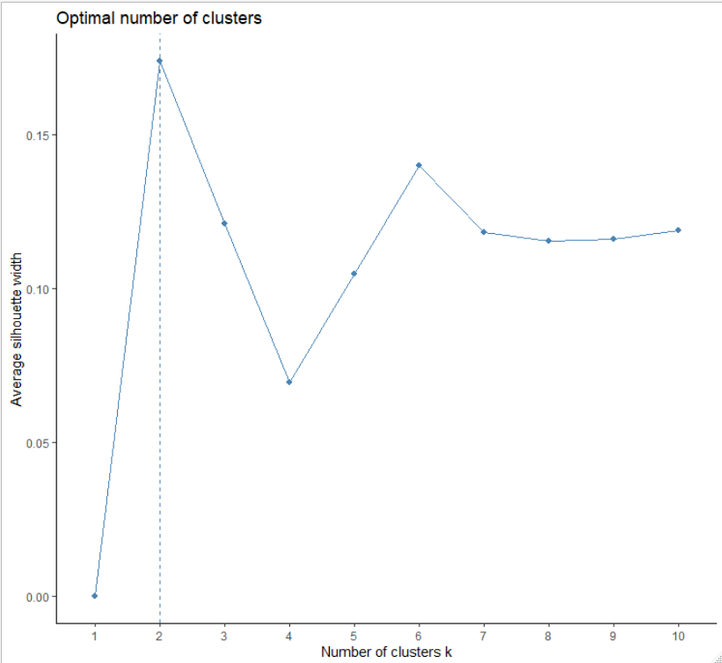
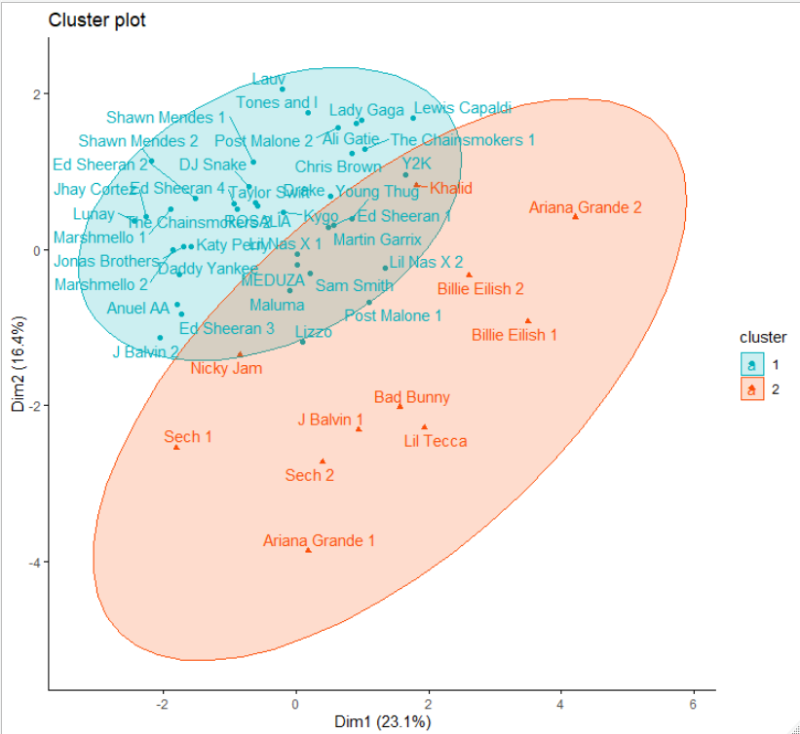
Partitional Clustering: K-Mediods(PAM)
Silhouette Method tells that optimal no. of clusters is 2
Clusters formed by taking k=2

Slide 29
Conclusion of Clustering:
There are 50 data points in given dataset for clustering analysis
The optimal number of clusters to analyze the dataset are 2
The proximity function performed best are Ward and Complete linkage
The singers can be classified into 2 groups based on variables
Improve recommendation system
Increase user engagement.

